Slide 1
For Live Session Unit 12
Javier Saldana

Slide 2
Predict Next 20 Years of Mortality

Slide 3
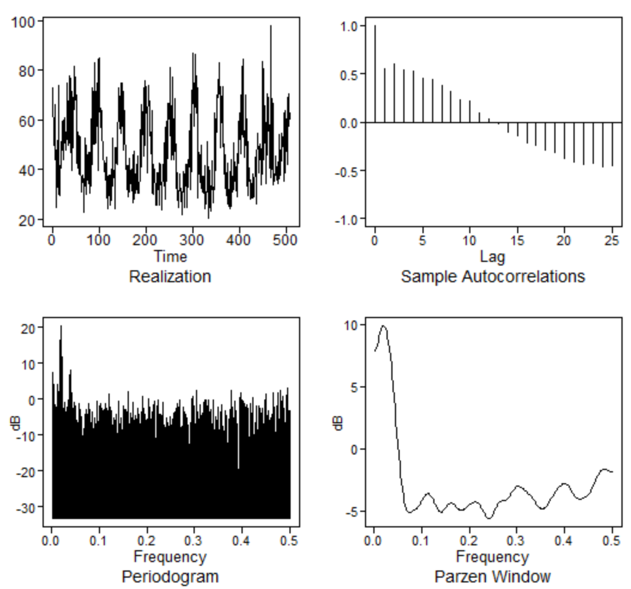
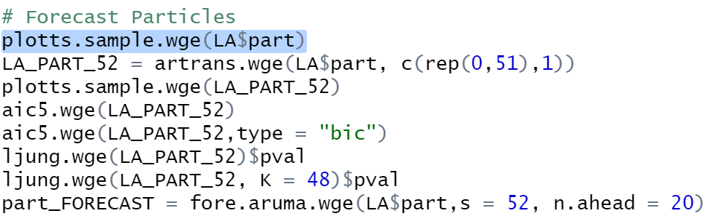
Forecast Particles
R Code
Plot of Raw Particles

Slide 4
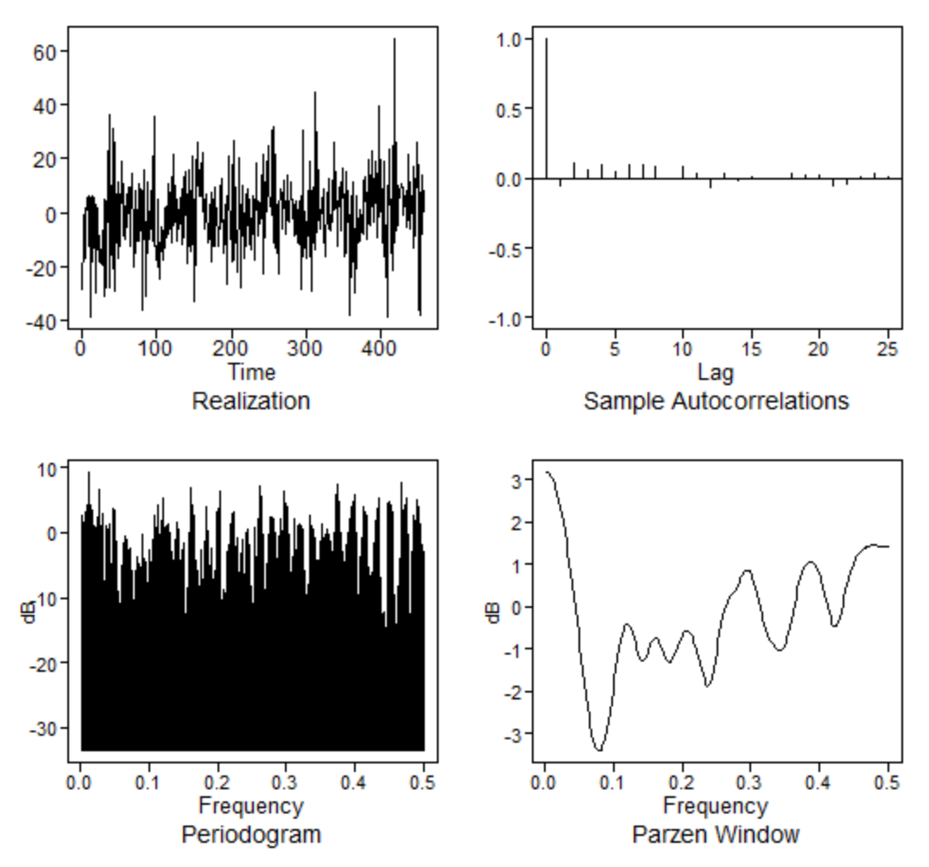
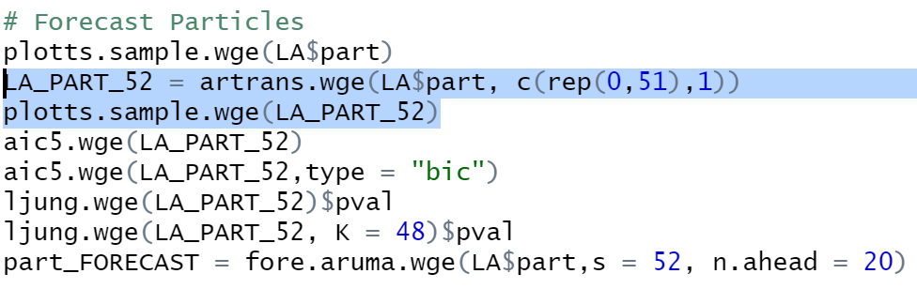
Forecast Particles
R Code
Plot of Differenced Particles

Slide 5
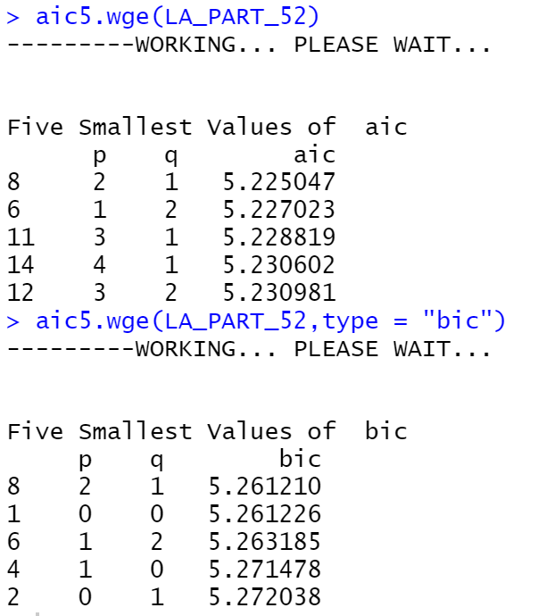
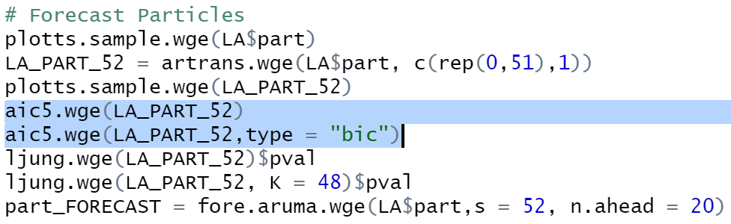
Forecast Particles
R Code
AIC/BIC
Appears to favor a 2,1 but the 0,0 is extremely close

Slide 6
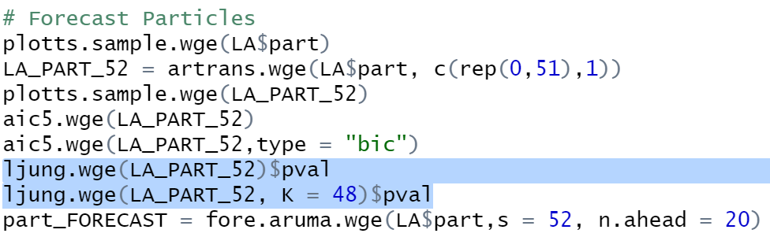
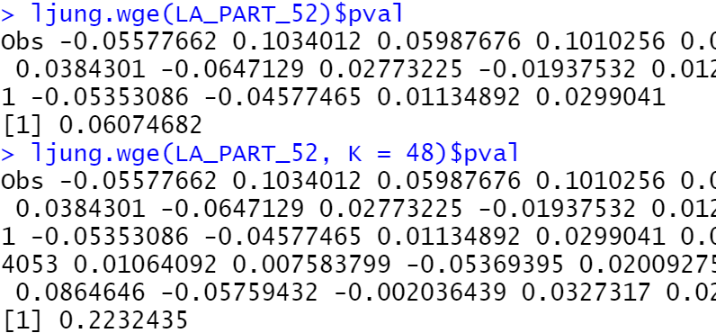
Forecast Particles
R Code
Ljung test
We fail to reject null hypothesis

Slide 7
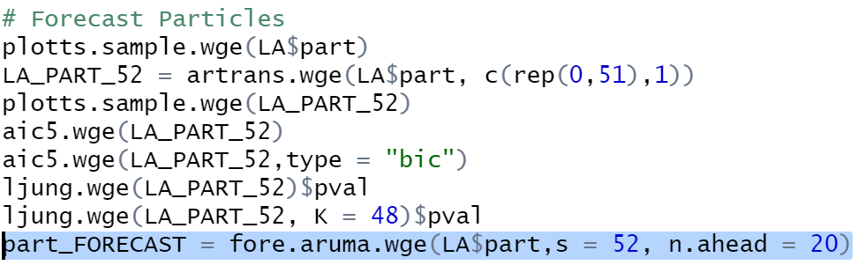
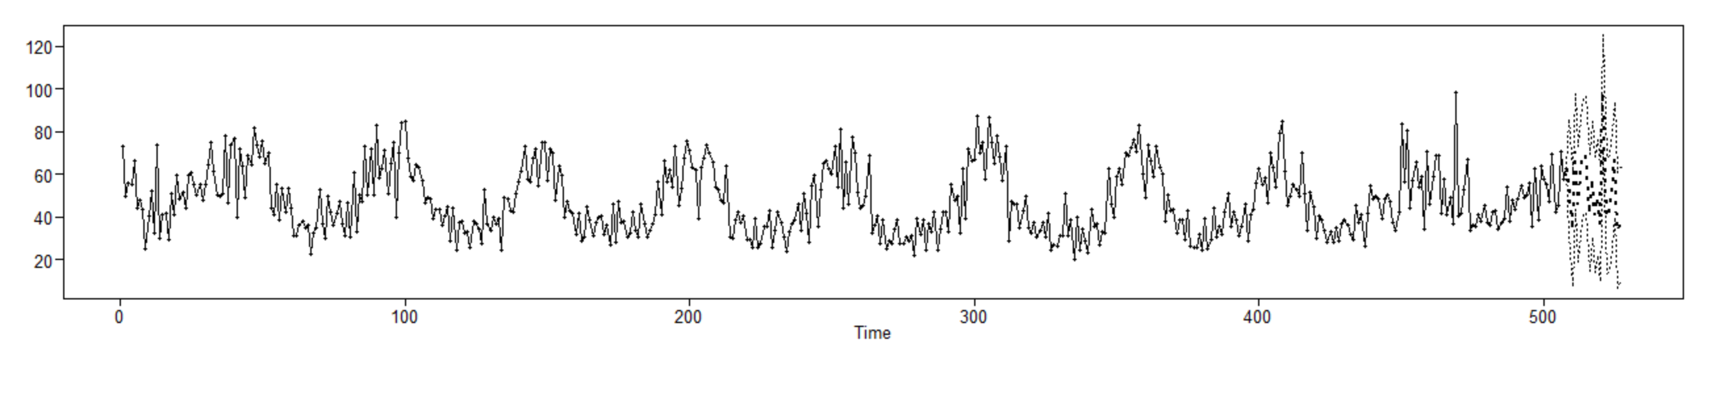
Forecast Particles
R Code
Predictions of Particles

Slide 8
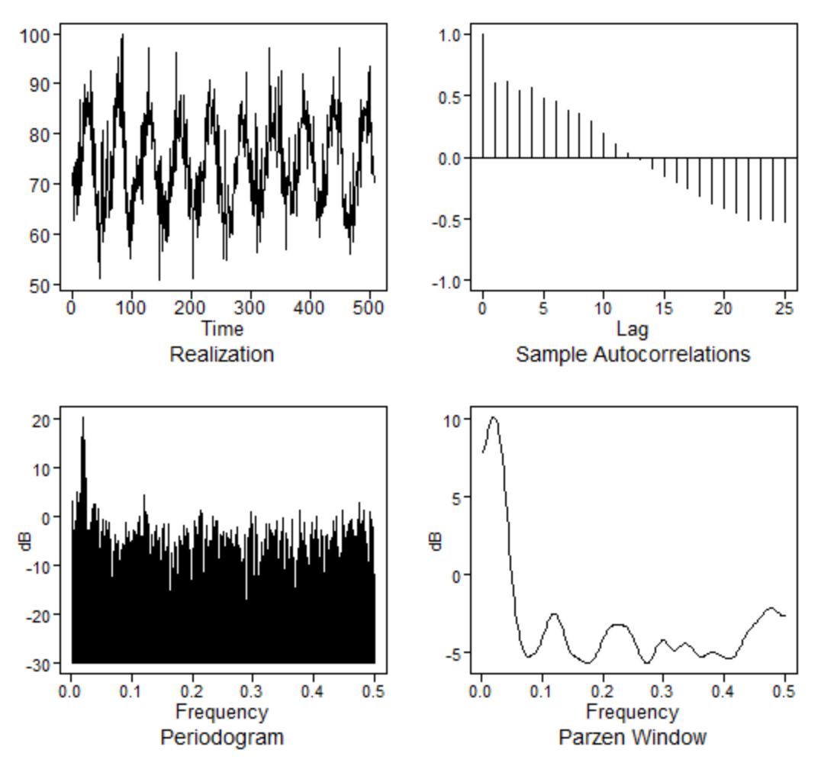
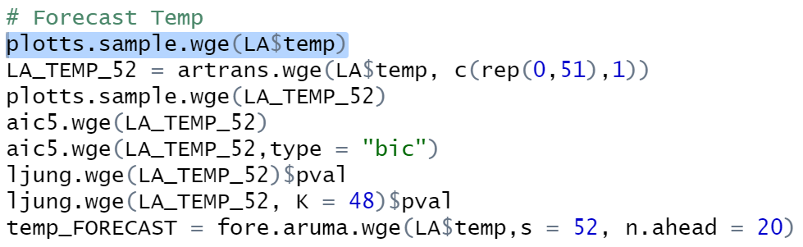
Forecast Temp
R Code
Plot of Raw Temp

Slide 9
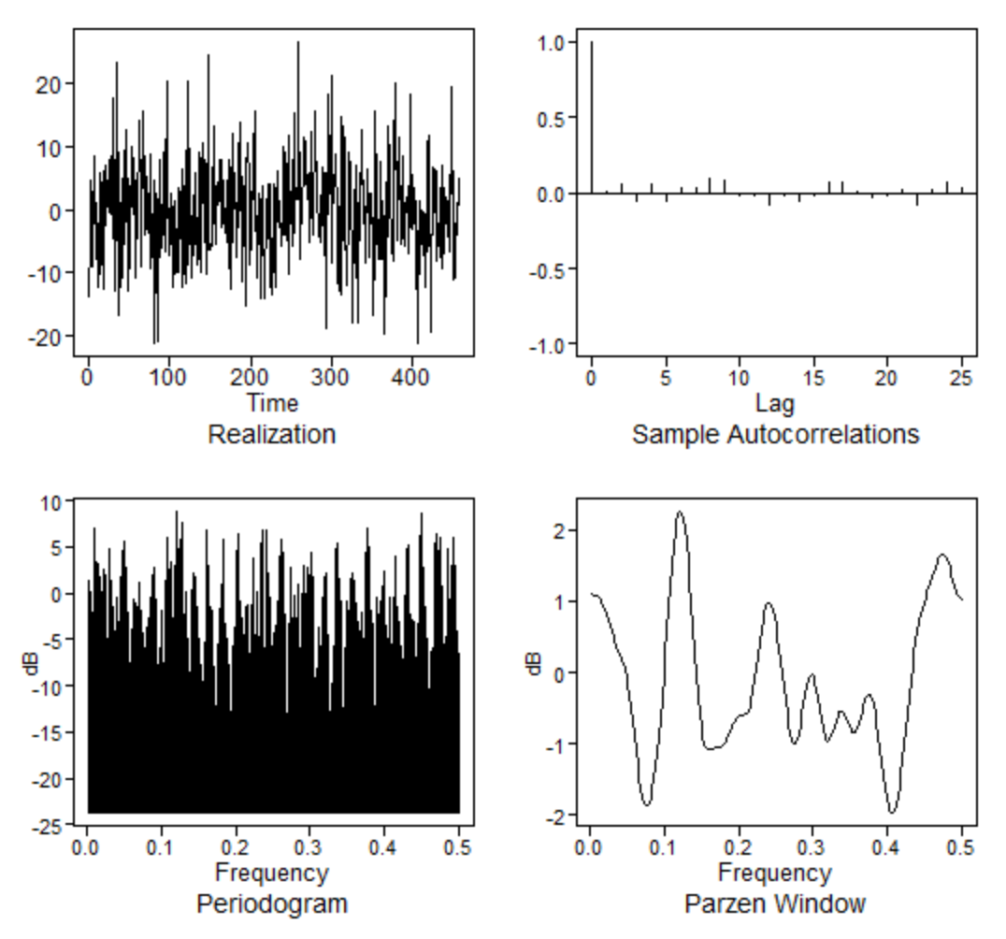
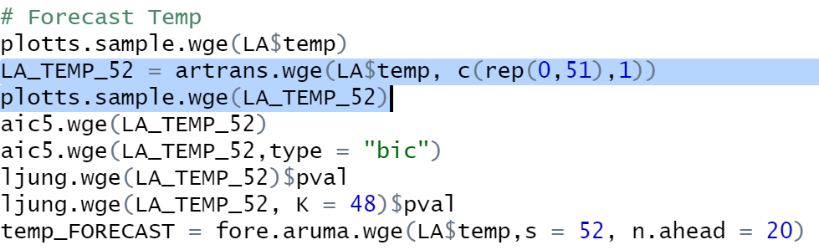
Forecast Temp
R Code
Plot of Differenced Temp

Slide 10
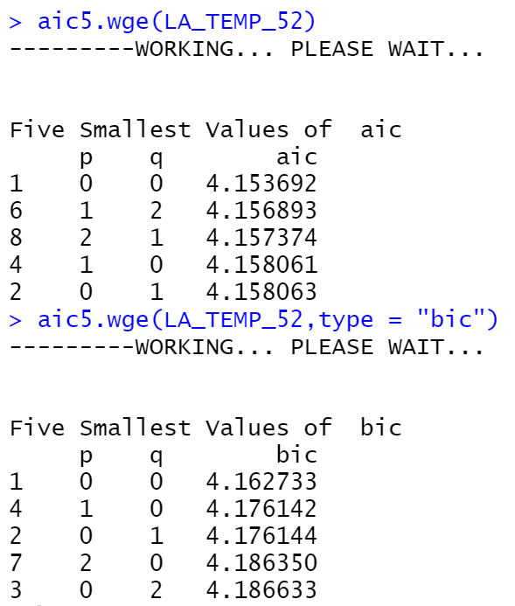
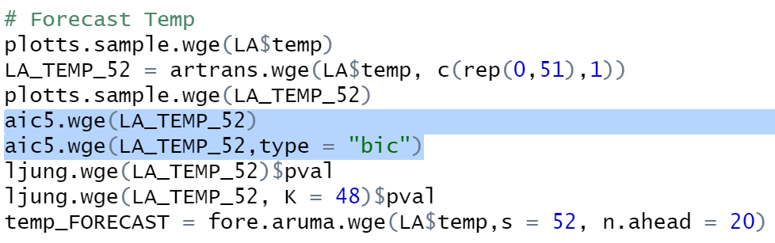
Forecast Temp
R Code
AIC/BIC
AIC and BIC in favor of 0,0

Slide 11
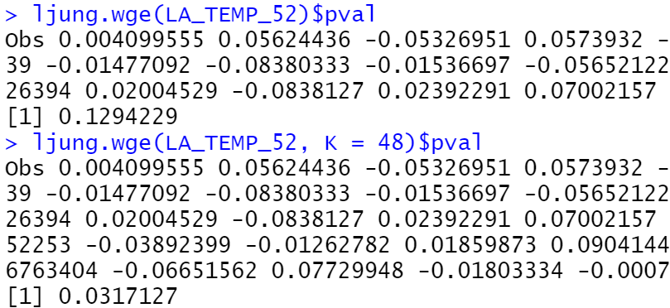
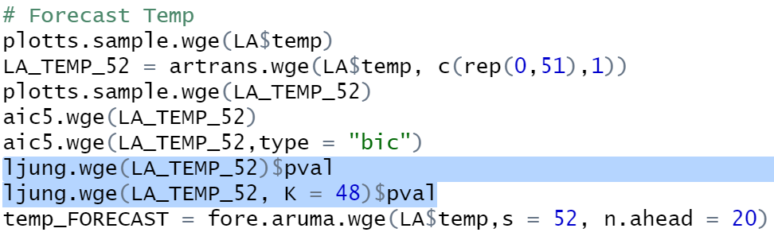
Forecast Temp
R Code
Ljung Test
We fail to reject the null hypothesis

Slide 12
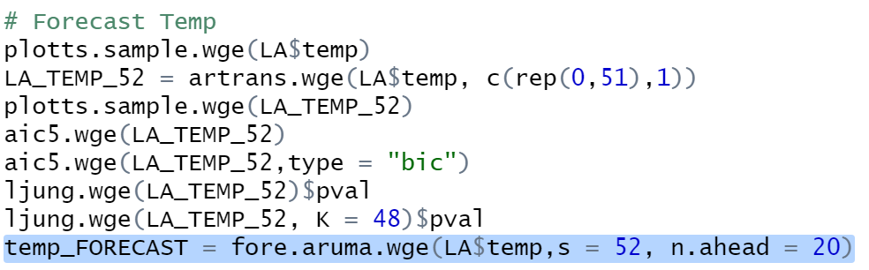
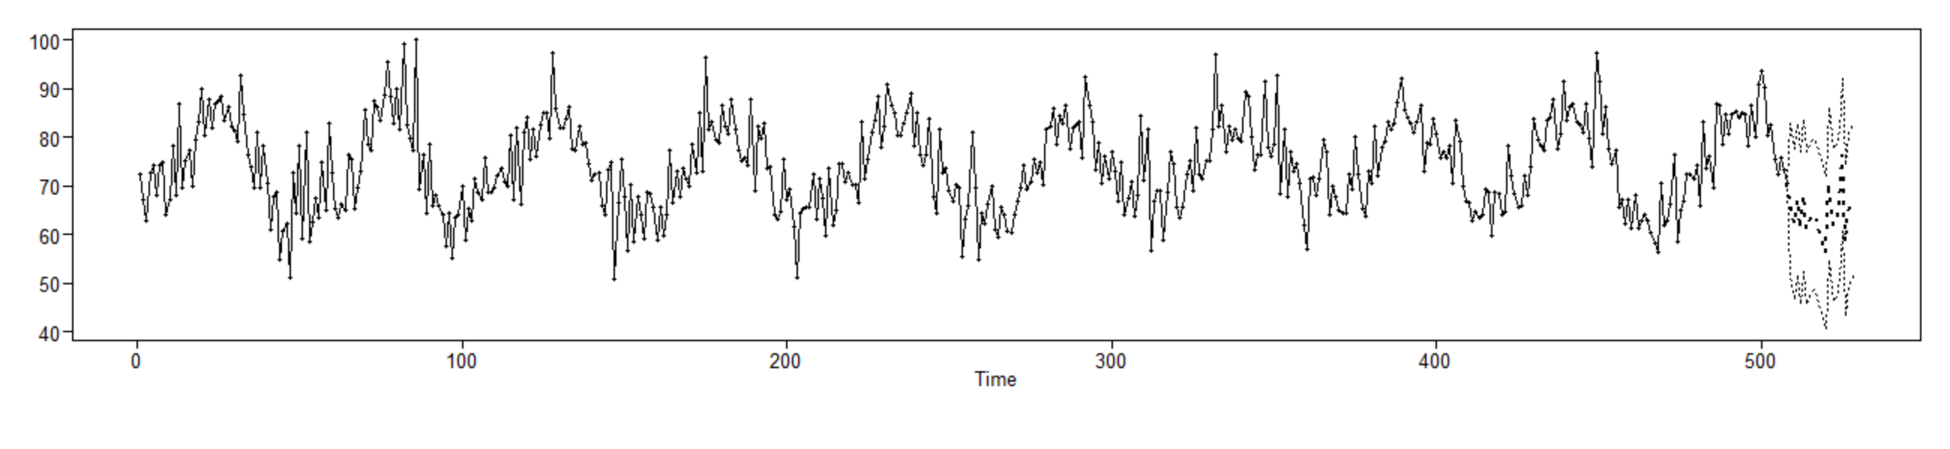
Forecast Temp
R Code
Temp Prediction

Slide 13
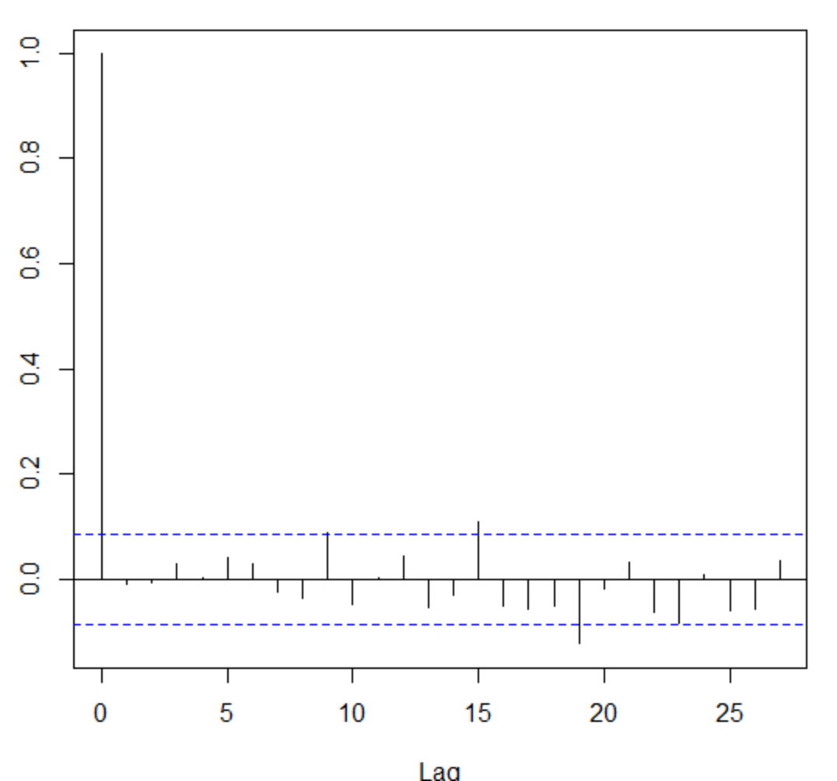

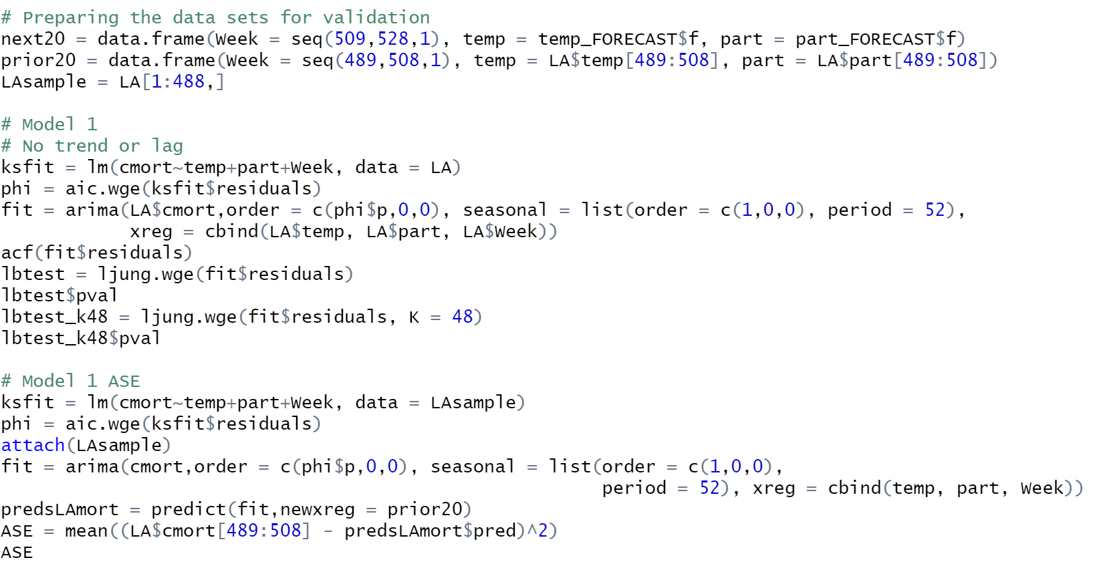


Model 1 – MLR (no lag, no trend)
R Code
Output

Slide 14

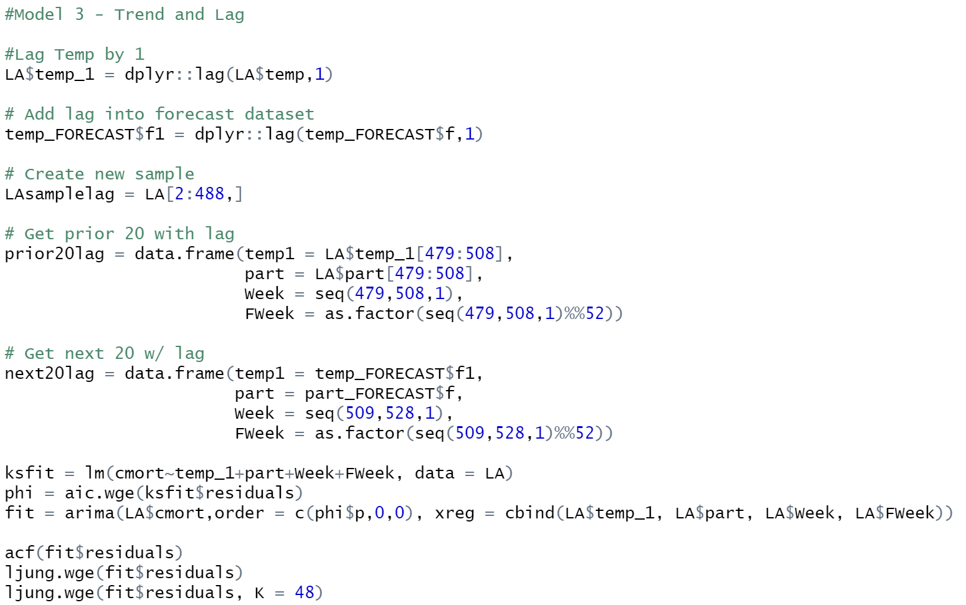

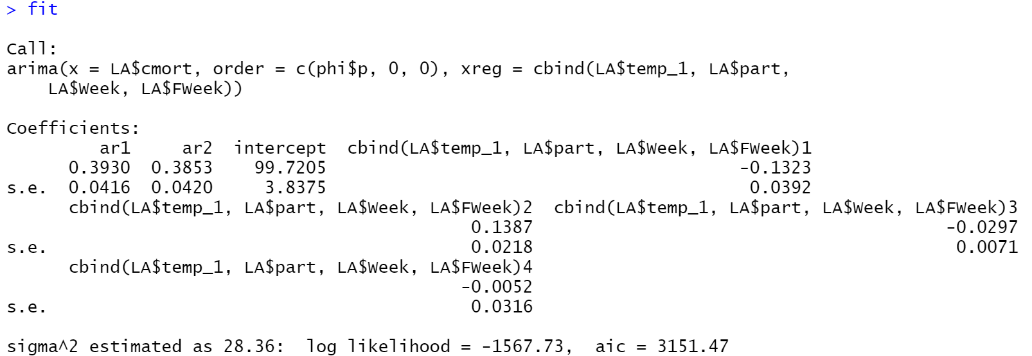
Model 2 – MLR (lag & trend)
R Code
Output

Slide 15
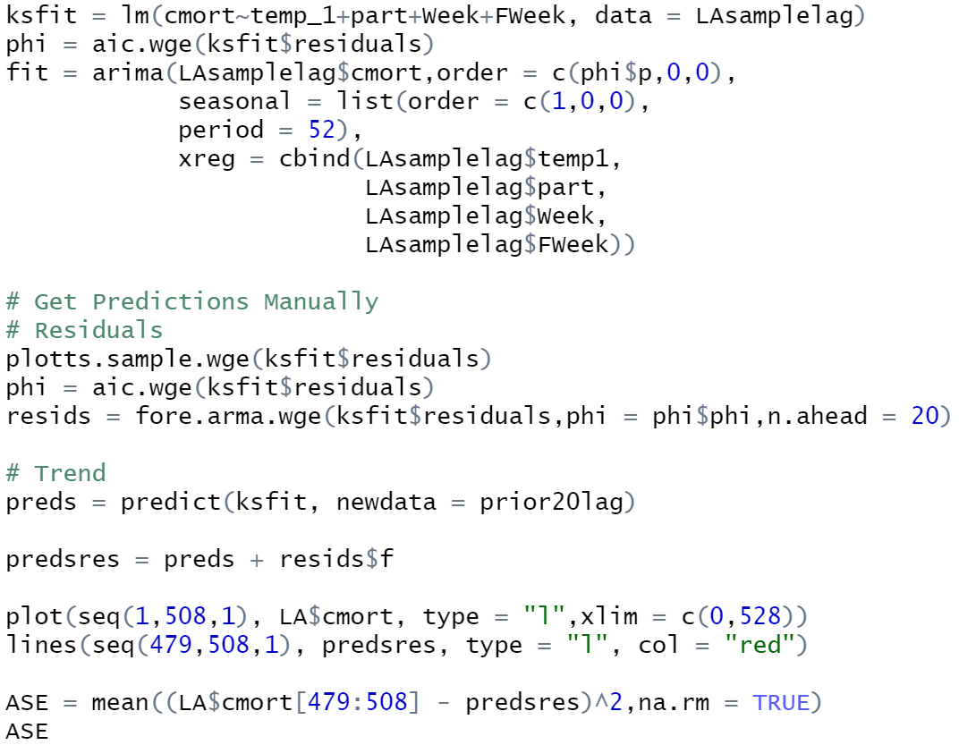
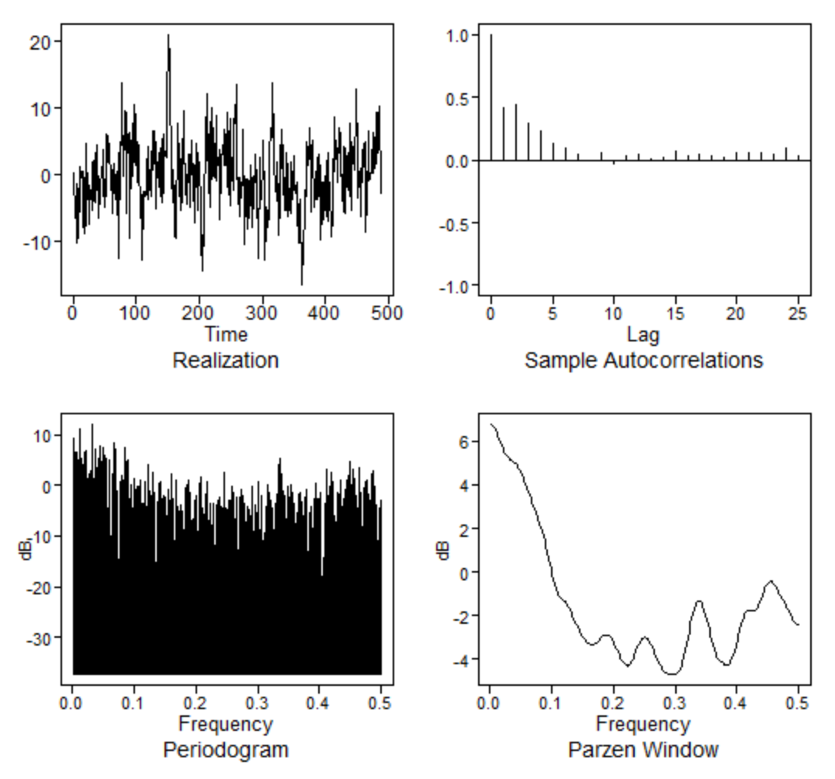
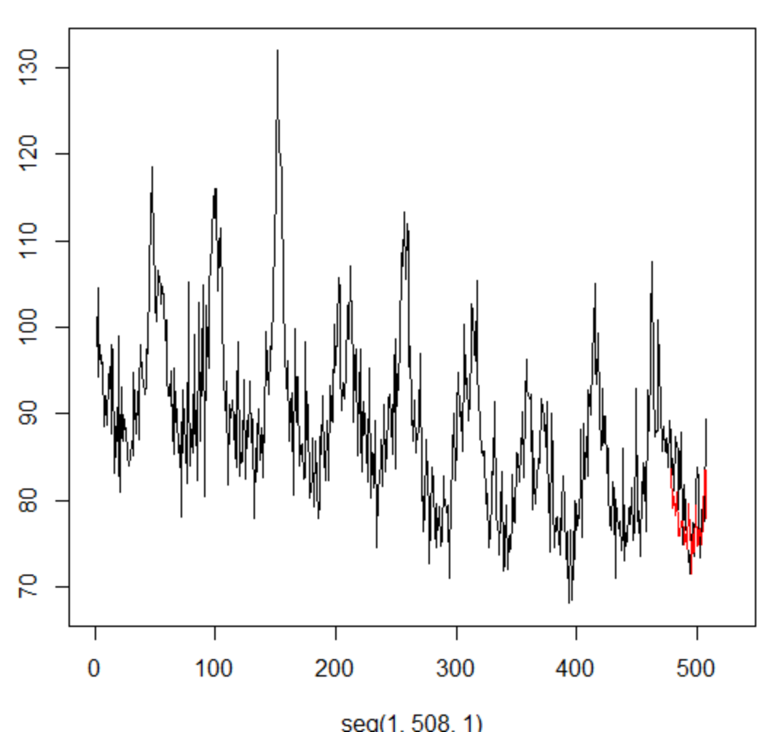

Model 2 – MLR (lag & trend) contd
R Code
Output

Slide 16
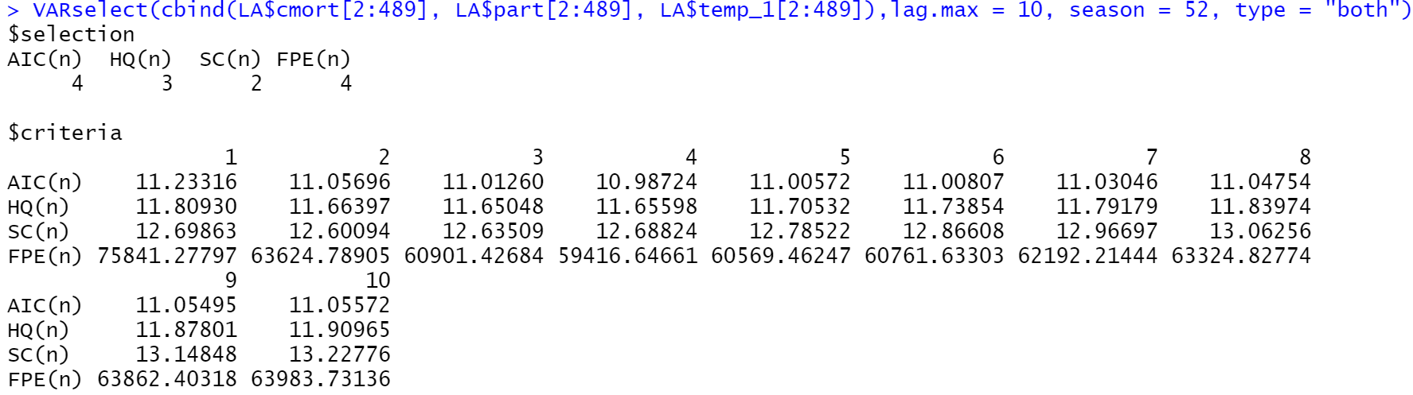
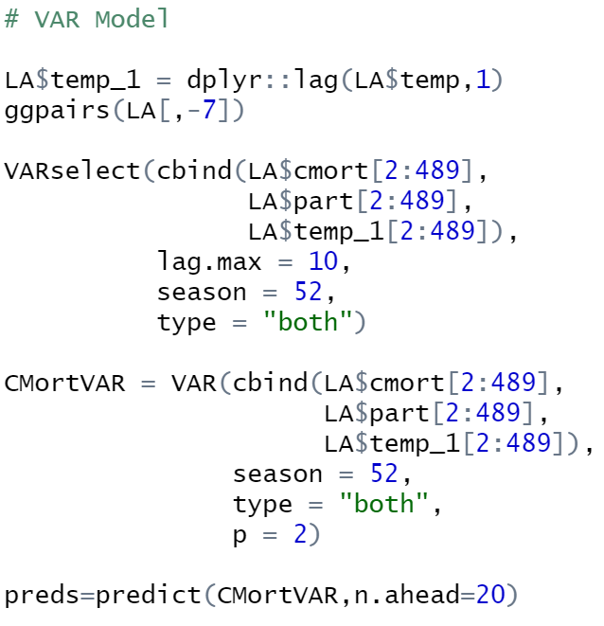
Model 3 – VAR (lag & trend)
R Code
Output

Slide 17
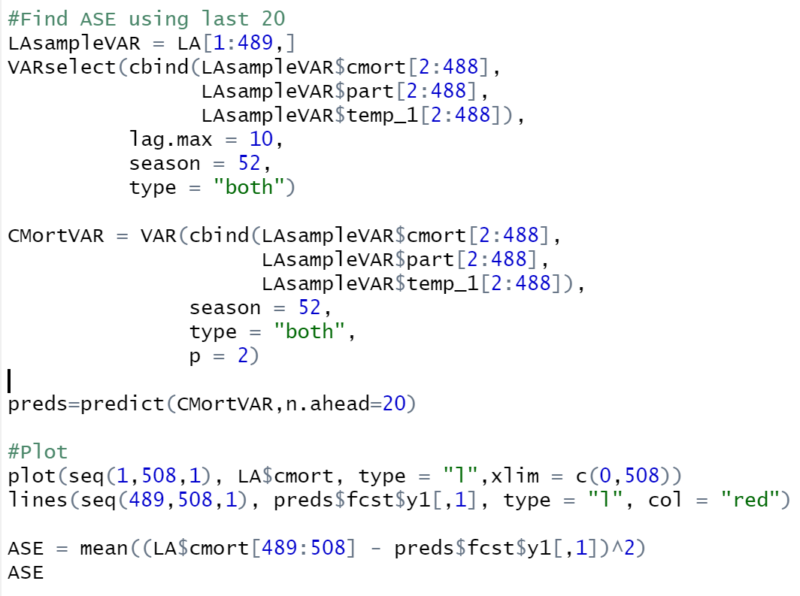
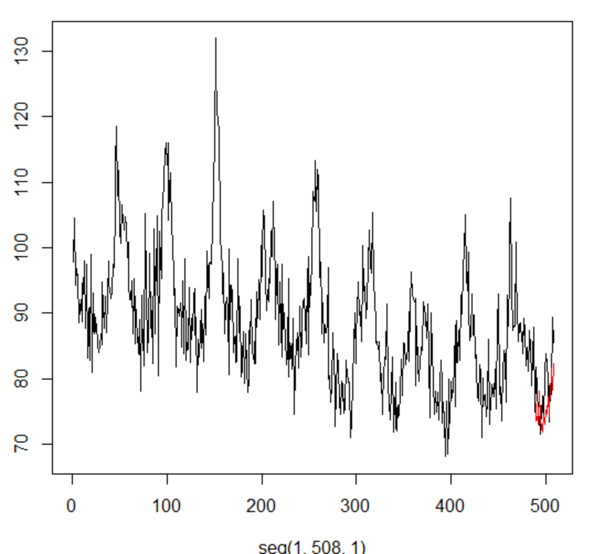

Model 3 – VAR (lag & trend)
R Code
Output

Slide 18
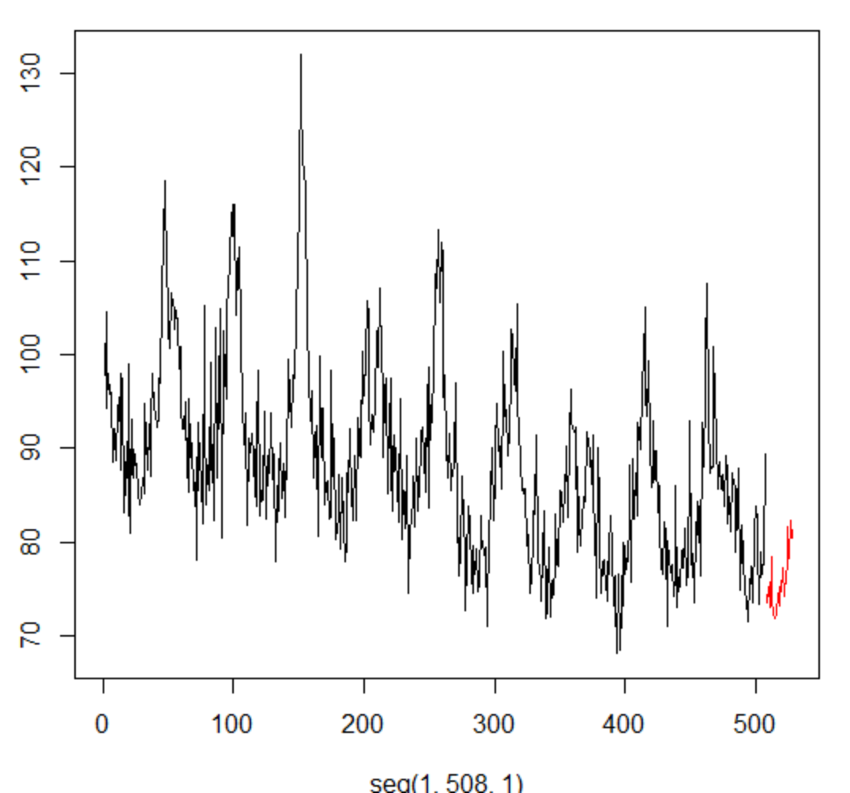
Part I - Conclusion
Since
Model
In this case, the VAR model seems more useful in predicting the future values. The model demonstrated a lower ASE than the other models.

Slide 19
Business Ads/Sales

Slide 20
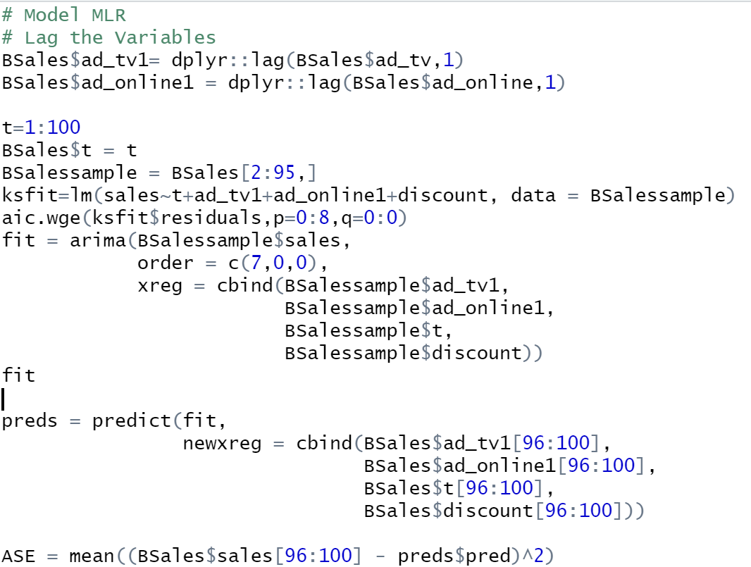
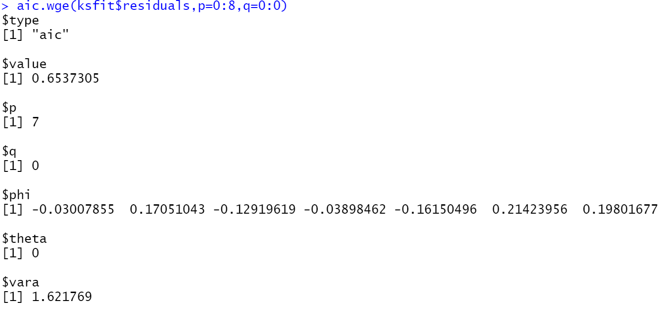

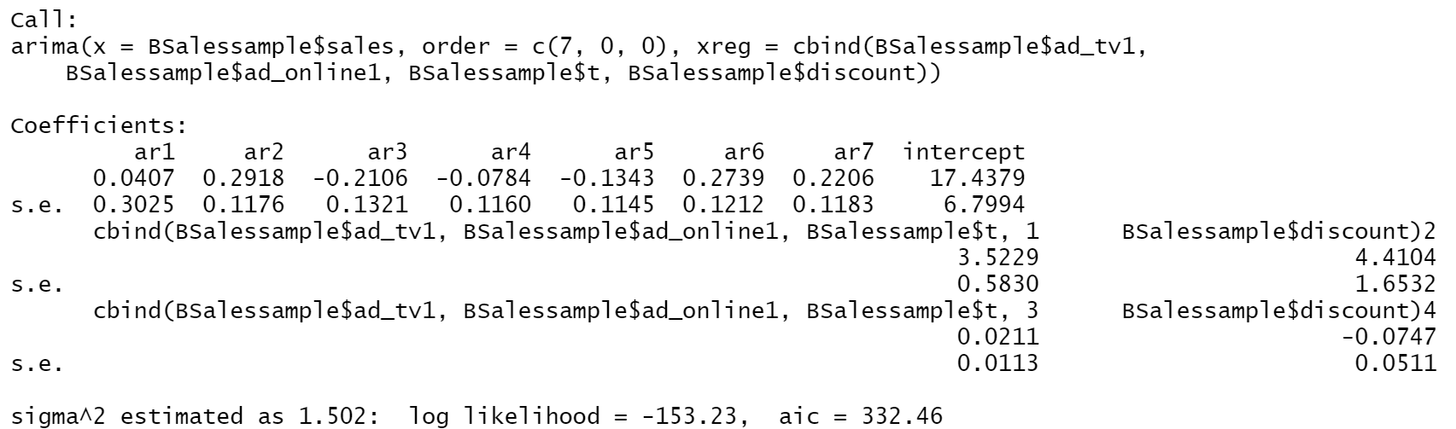
MLR Model
R code

Slide 21
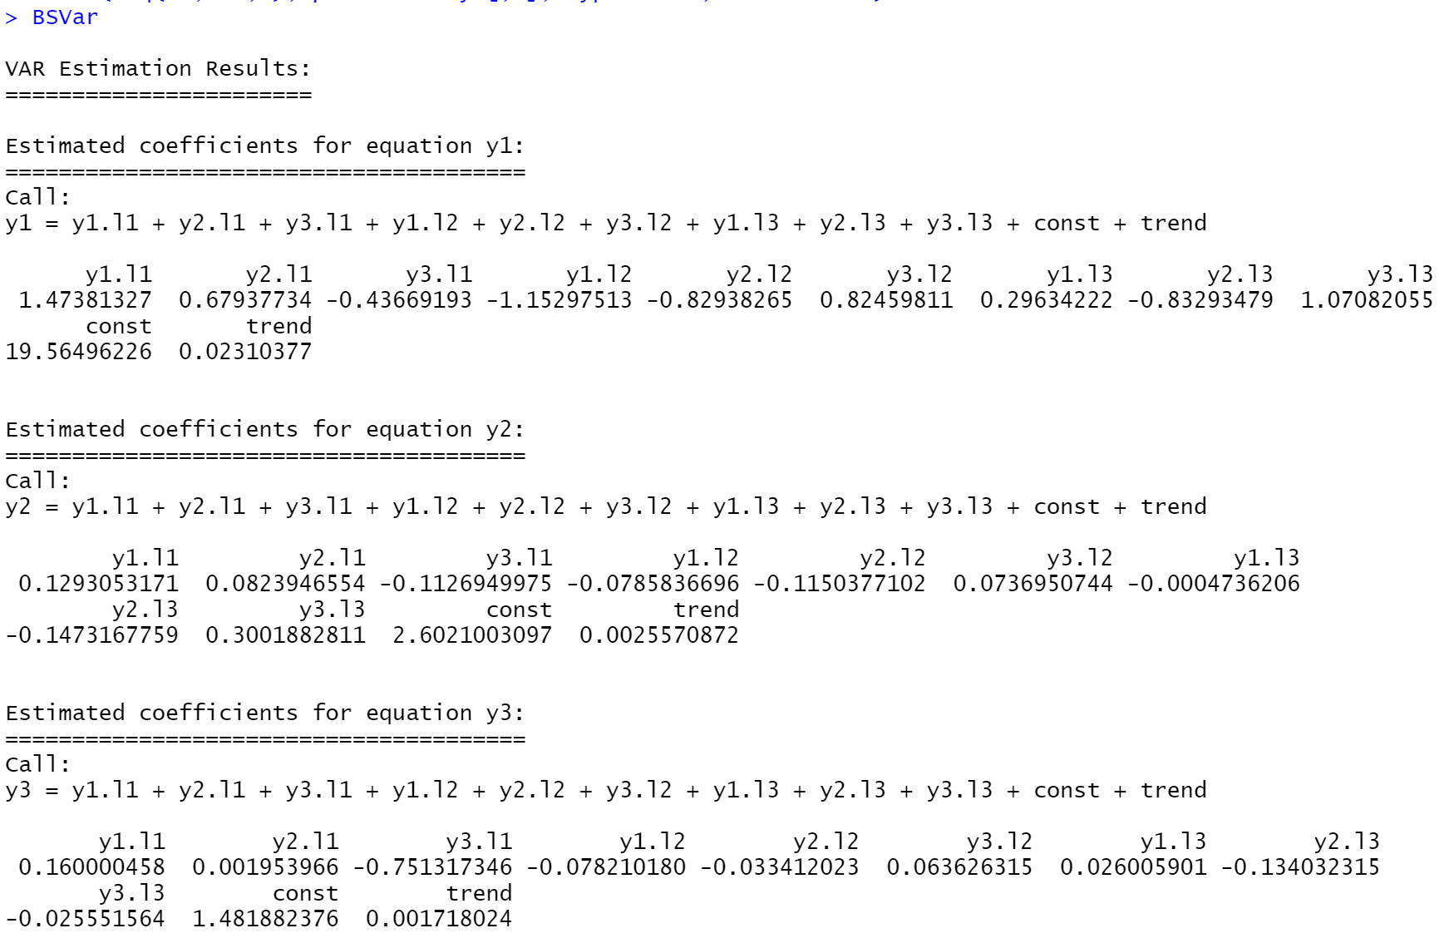

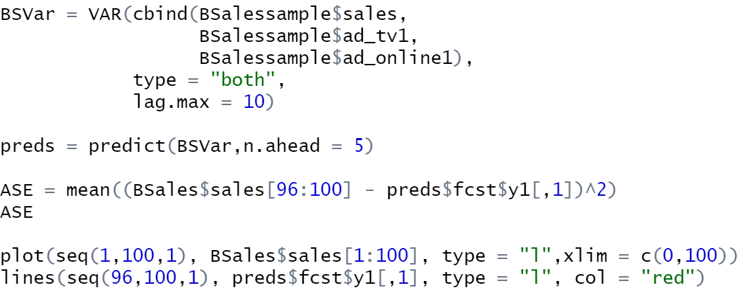
VAR Model
R code
Output

Slide 22
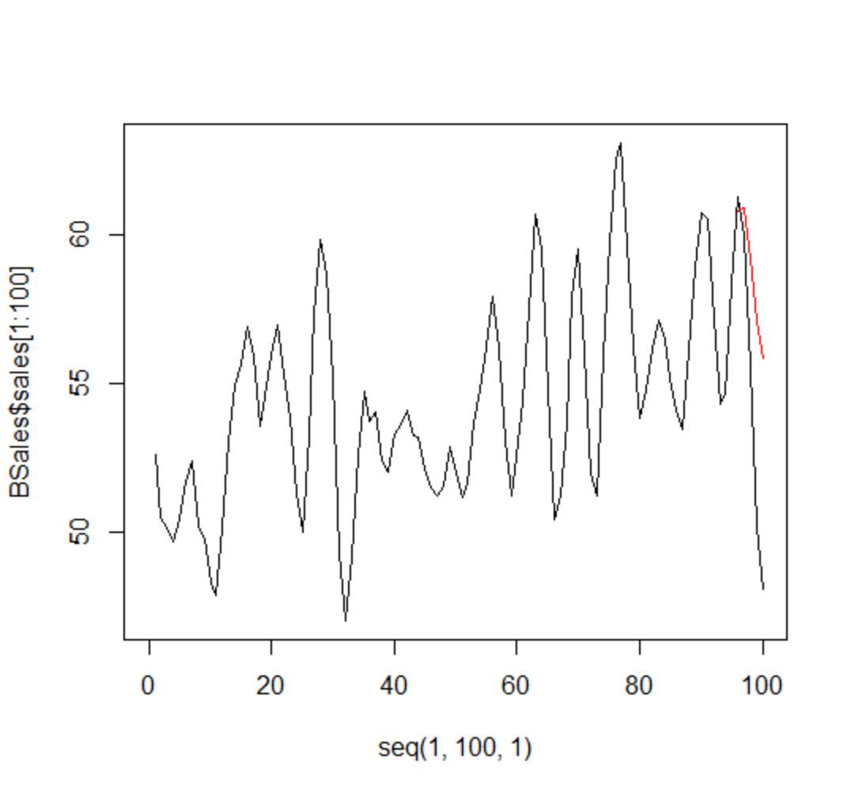
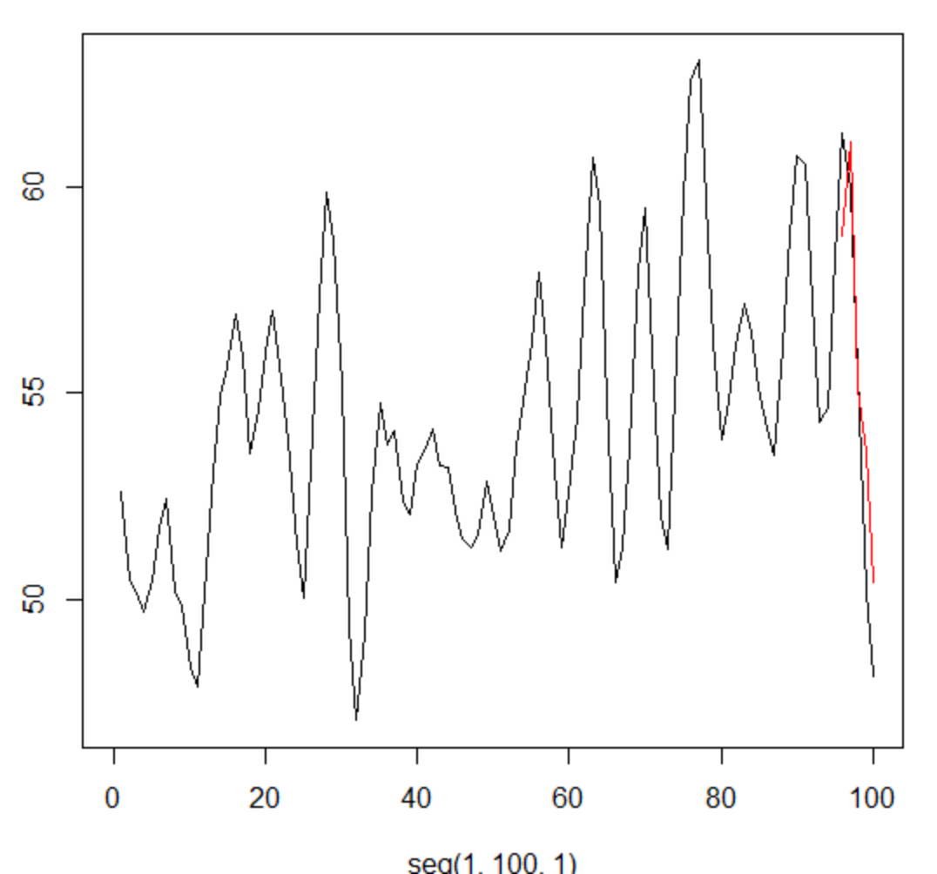
Model Comparison
I believe the MLR model is a more appropriate model considering the ASE is lower and the graphical output clearly shows the prediction following the trend. The VAR model appears to be leaning too far away from the direction of the data.
VAR
MLR

